Slide 1
Customer Acquisition Financial Report
NAME : ASHA SANDEEP
EMAIL ID:ashasandeepkashyap@gmail.com
noida

Slide 2
objective
AcmeTech is preparing a digital marketing campaign to scale customer acquisition in the next quarter. As part of the Growth team, your task is to prepare a financial plan for acquiring 1,000 new paid customers.
The management has provided you with several data points. Your role is to perform the calculations, build a mini dashboard, and make a recommendation on the campaign's financial viability.

Slide 3
Project Overview
Timeline :- 24th march,2025.
Deadline :- 27th march,2025.

Slide 4
Methodology
Calculations:
1.Base LTV
a.𝐵𝑎𝑠𝑒 𝐿𝑉𝑇 = (𝑀𝑜𝑛𝑡ℎ𝑙𝑦 𝑆𝑢𝑏𝑠𝑐𝑟𝑖𝑝𝑡𝑖𝑜𝑛 𝐹𝑒𝑒 × 𝐺𝑟𝑜𝑠𝑠 𝑀𝑎𝑟𝑔𝑖𝑛) ÷ 𝐶ℎ𝑢𝑟𝑛 𝑅𝑎𝑡𝑒
𝐵𝑎𝑠𝑒 𝐿𝑉𝑇 = (£30 × 0. 6) ÷ 0. 2
𝐵𝑎𝑠𝑒 𝐿𝑉𝑇 = £90
2.Adjusted LTV
a.Premium Customer (10 %)
𝑃𝑟𝑒𝑚𝑖𝑢𝑚 𝑐𝑢𝑠𝑡𝑜𝑚𝑒𝑟 = 𝐵𝑎𝑠𝑒 𝐿𝑉𝑇 + (𝐵𝑎𝑠𝑒 𝐿𝑉𝑇 × 0. 10)
𝑃𝑟𝑒𝑚𝑖𝑢𝑚 𝑐𝑢𝑠𝑡𝑜𝑚𝑒𝑟 = £99
b.Standar Customer (0 %)
𝑆𝑡𝑎𝑛𝑑𝑎𝑟𝑑 𝑐𝑢𝑠𝑡𝑜𝑚𝑒𝑟 = 𝐵𝑎𝑠𝑒 𝐿𝑉𝑇 + (𝐵𝑎𝑠𝑒 𝐿𝑉𝑇 × 0)
𝑆𝑡𝑎𝑛𝑑𝑎𝑟𝑑 𝑐𝑢𝑠𝑡𝑜𝑚𝑒𝑟 = £90
c.Trial Customer (20 %)
𝑇𝑟𝑖𝑎𝑙 𝐶𝑢𝑠𝑡𝑜𝑚𝑒𝑟 = 𝐵𝑎𝑠𝑒 𝐿𝑉𝑇 + (𝐵𝑎𝑠𝑒 𝐿𝑉𝑇 × 0. 20)
𝑇𝑟𝑖𝑎𝑙 𝐶𝑢𝑠𝑡𝑜𝑚𝑒𝑟 = £72

Slide 5
Keyfeatures
3.Estimated Ad Budget (CAC Method)
a.𝐸𝑠𝑡𝑖𝑚𝑎𝑡𝑒𝑑 𝐴𝑑 𝐵𝑢𝑑𝑔𝑒𝑡 (𝐶𝐴𝐶 𝑀𝑒𝑡ℎ𝑜𝑑) = 𝑇𝑎𝑟𝑔𝑒𝑡 𝐶𝑢𝑠𝑡𝑜𝑚𝑒𝑟𝑠 * 𝐶𝐴𝐶
𝐸𝑠𝑡𝑖𝑚𝑎𝑡𝑒𝑑 𝐴𝑑 𝐵𝑢𝑑𝑔𝑒𝑡 (𝐶𝐴𝐶 𝑀𝑒𝑡ℎ𝑜𝑑) = 1000 × 330
𝐸𝑠𝑡𝑖𝑚𝑎𝑡𝑒𝑑 𝐴𝑑 𝐵𝑢𝑑𝑔𝑒𝑡 (𝐶𝐴𝐶 𝑀𝑒𝑡ℎ𝑜𝑑 ) = £330, 000
4.Ad Budget (CPM Method)
a.𝑇𝑜𝑡𝑎𝑙 𝐶𝑙𝑖𝑐𝑘𝑠 𝑅𝑒𝑞𝑢𝑖𝑟𝑒𝑑 = 𝑇𝑎𝑟𝑔𝑒𝑡 𝐶𝑢𝑠𝑡𝑜𝑚𝑒𝑟 / 𝐶𝑜𝑛𝑣𝑒𝑟𝑠𝑖𝑜𝑛 𝑅𝑎𝑡𝑒
𝑇𝑜𝑡𝑎𝑙 𝐶𝑙𝑖𝑐𝑘𝑠 𝑅𝑒𝑞𝑢𝑖𝑟𝑒𝑑 = 1000 ÷ 0. 05
𝑇𝑜𝑡𝑎𝑙 𝐶𝑙𝑖𝑐𝑘𝑠 𝑅𝑒𝑞𝑢𝑖𝑟𝑒𝑑 = 20, 000
b.𝑇𝑜𝑡𝑎𝑙 𝐼𝑚𝑝𝑟𝑒𝑠𝑠𝑖𝑜𝑛𝑠 𝑁𝑒𝑒𝑑𝑒𝑑 = 𝑇𝑜𝑡𝑎𝑙 𝐶𝑙𝑖𝑐𝑘𝑠 ÷ 𝐶𝑇𝑅
𝑇𝑜𝑡𝑎𝑙 𝐼𝑚𝑝𝑟𝑒𝑠𝑠𝑖𝑜𝑛𝑠 𝑁𝑒𝑒𝑑𝑒𝑑 = 20000 ÷ 0. 02
𝑇𝑜𝑡𝑎𝑙 𝐼𝑚𝑝𝑟𝑒𝑠𝑠𝑖𝑜𝑛𝑠 𝑁𝑒𝑒𝑑𝑒𝑑 = 1, 000, 000

Slide 6
Keyfeatures
c.Ad budget based on CPM
𝐴𝑑 𝑏𝑢𝑑𝑔𝑒𝑡 𝑏𝑎𝑠𝑒𝑑 𝑜𝑛 𝐶𝑃𝑀 = ( 𝑇𝑜𝑡𝑎𝑙 𝐼𝑚𝑝𝑟𝑒𝑠𝑠𝑖𝑜𝑛𝑠 / 1000 ) * 𝐶𝑃𝑀
𝐴𝑑 𝑏𝑢𝑑𝑔𝑒𝑡 𝑏𝑎𝑠𝑒𝑑 𝑜𝑛 𝐶𝑃𝑀 = (1, 000, 000 / 1000 ) * 10
𝐴𝑑 𝑏𝑢𝑑𝑔𝑒𝑡 𝑏𝑎𝑠𝑒𝑑 𝑜𝑛 𝐶𝑃𝑀 = 10, 000

Slide 7
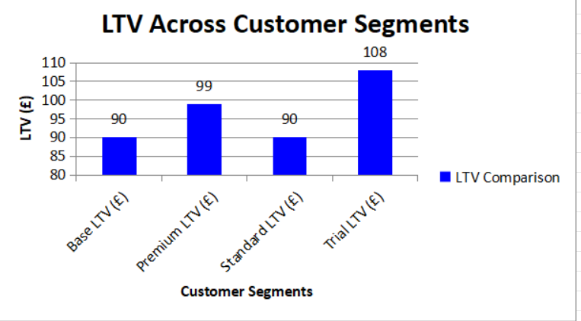
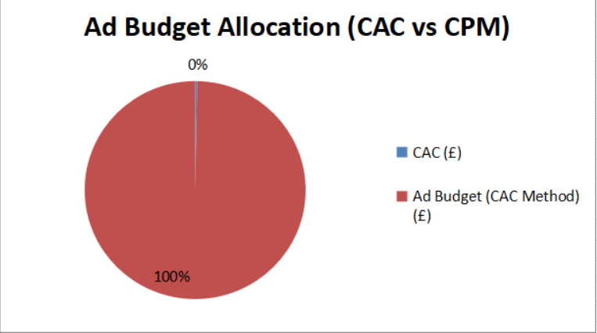
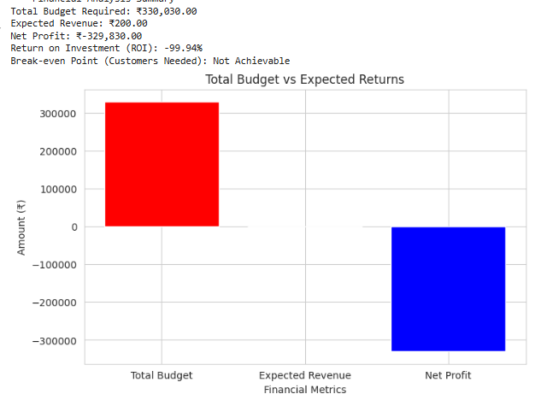
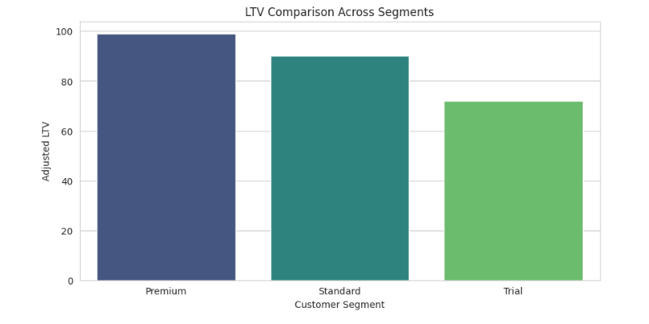
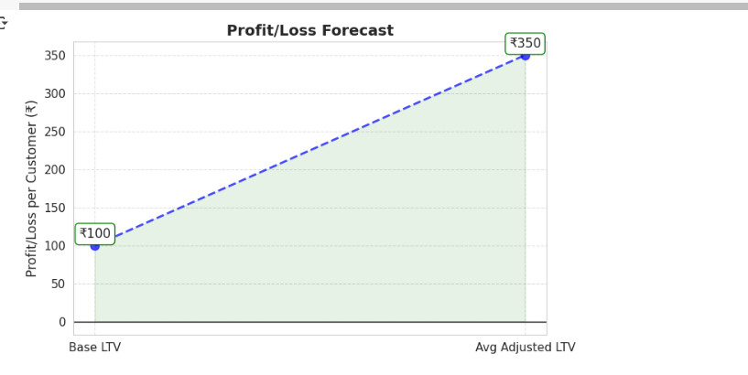
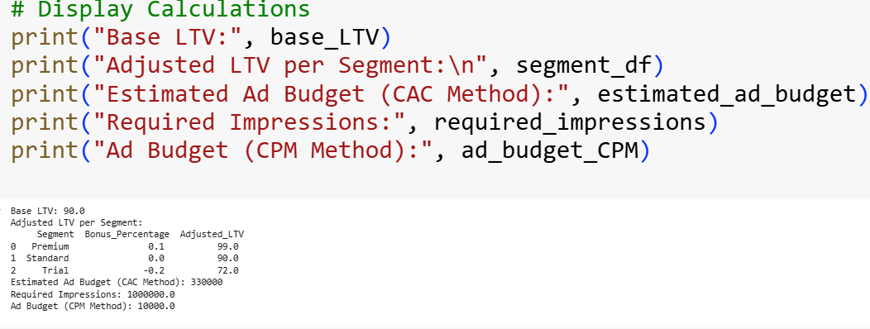
Keyfeatures

Slide 8
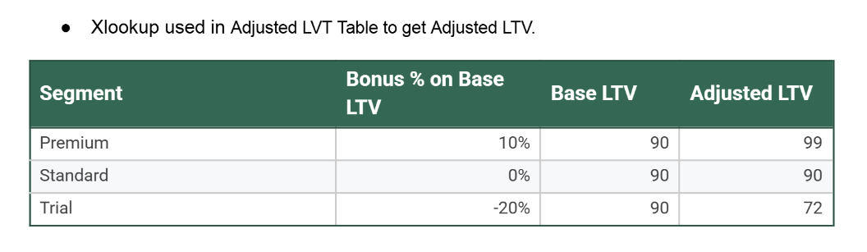
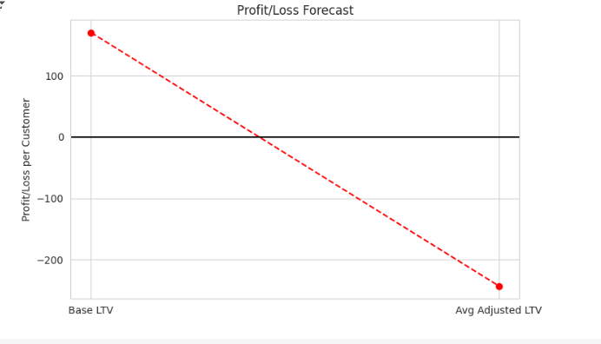
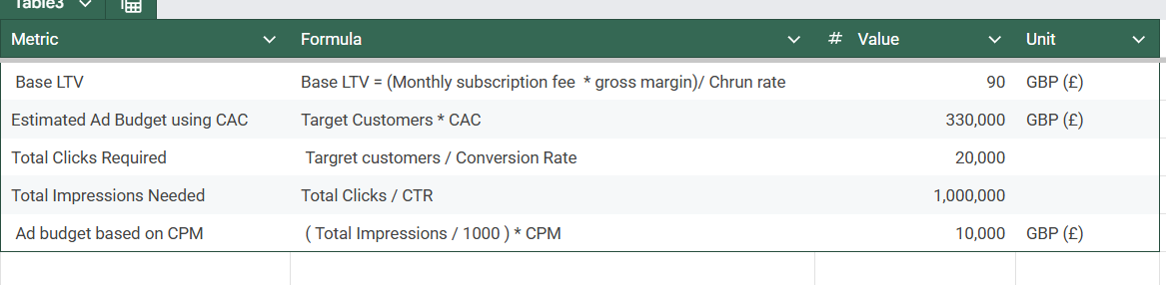
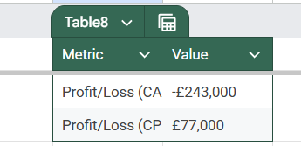
keyfeatures

Slide 9
Conclusion
Conclusion:
Proceed with the CPM-Based Strategy
The CPM-based approach is profitable, while the CAC-based approach results in heavy losses. AcmeTech should focus on improving retention and optimizing ad spending to maximize returns.

Slide 10
Recommendation
Recommendation: Financial Viability Analysis:
1.CAC-Based Budget Approach (❌ Not Visible):
a.The cost per acquisition (£330 per customer) results in a huge loss of £243,000, as the LTV (£90) is far lower than the CAC.
b.Customer Lifetime Value is too low compared to acquisition cost, making this approach unsustainable.
2.CPM-Based Budget Approach (✅ Viable & Profitable):
a..Advertising through impressions (CPM method) costs only £10,000 while generating £87,000 in revenue.
b.This results in a profit of £77,000, making it a far better strategy.

Slide 11
Thank you

